Slide 1
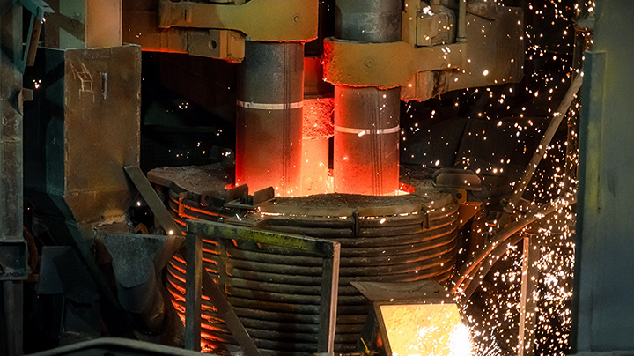
TUFF SILICO MANGANESE
COMMITTED TO QUALITY

Slide 2
INTRODUCTION TO SILICO MANGANESE
Silico Manganese is an alloy of manganese, silicon and iron. It is a cost- effective blend of manganese and silicon and is normally the product of choice for steel manufacturers. It is consumed in all steel products and used in higher quantities in 200 series stainless steel, alloy steel and manganese steel. Silico Manganese is used as a deoxidizer and an alloying element in steel. Ferro Silico Manganese can be used as a substitute for Ferro Silicon and Ferro Manganese when added to make different types of steel.

Slide 3
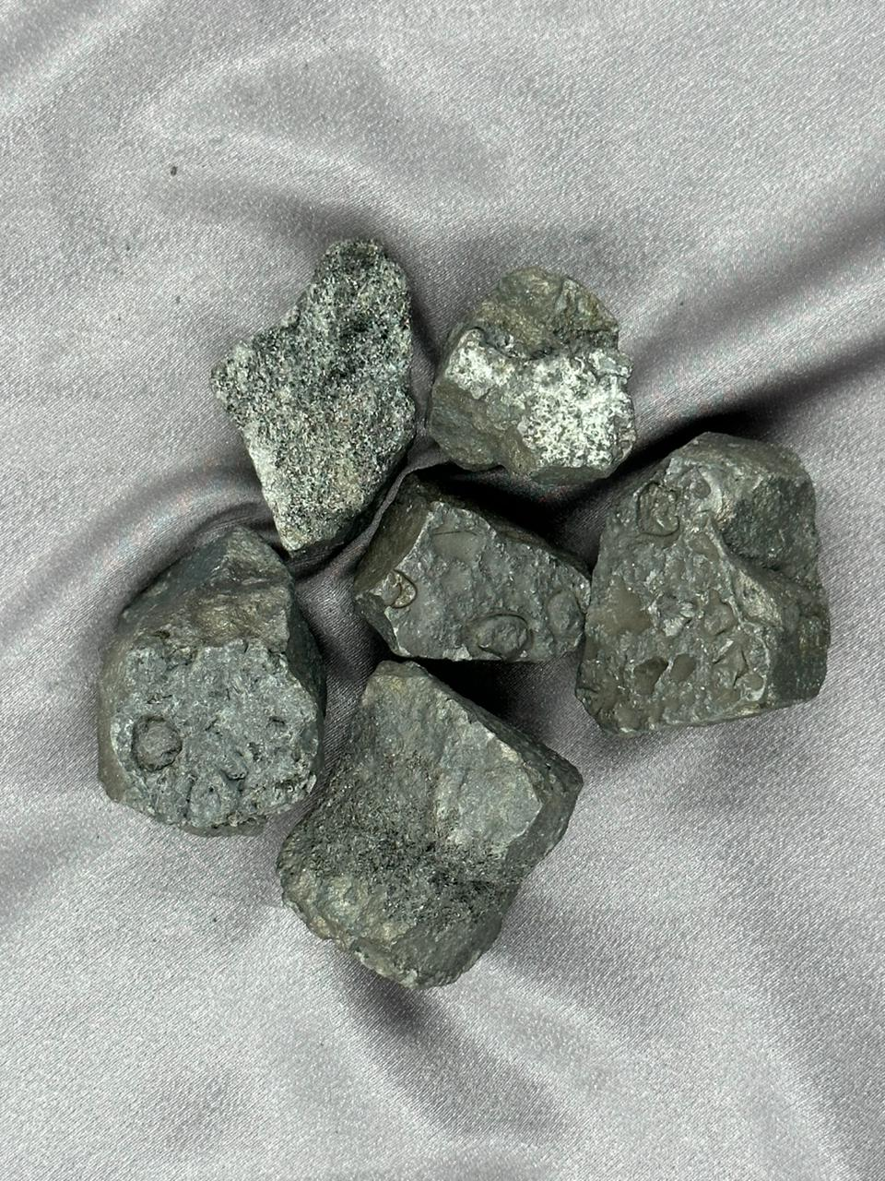
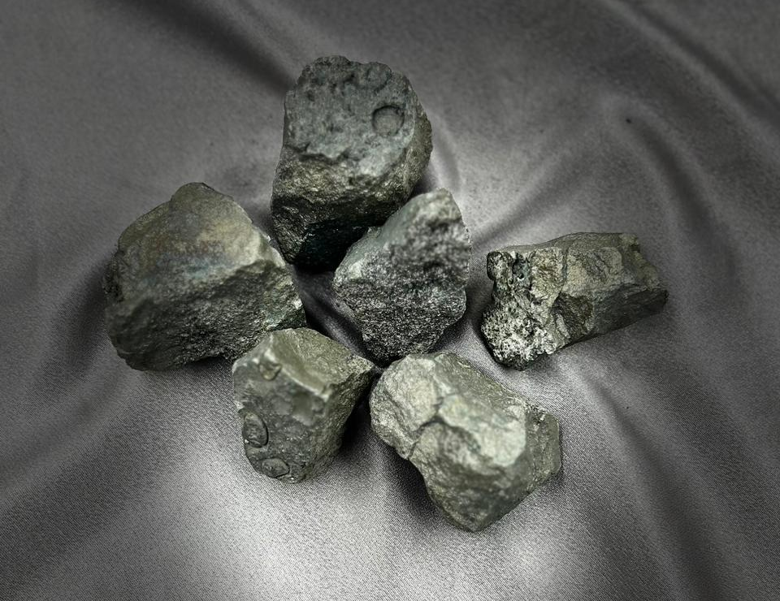
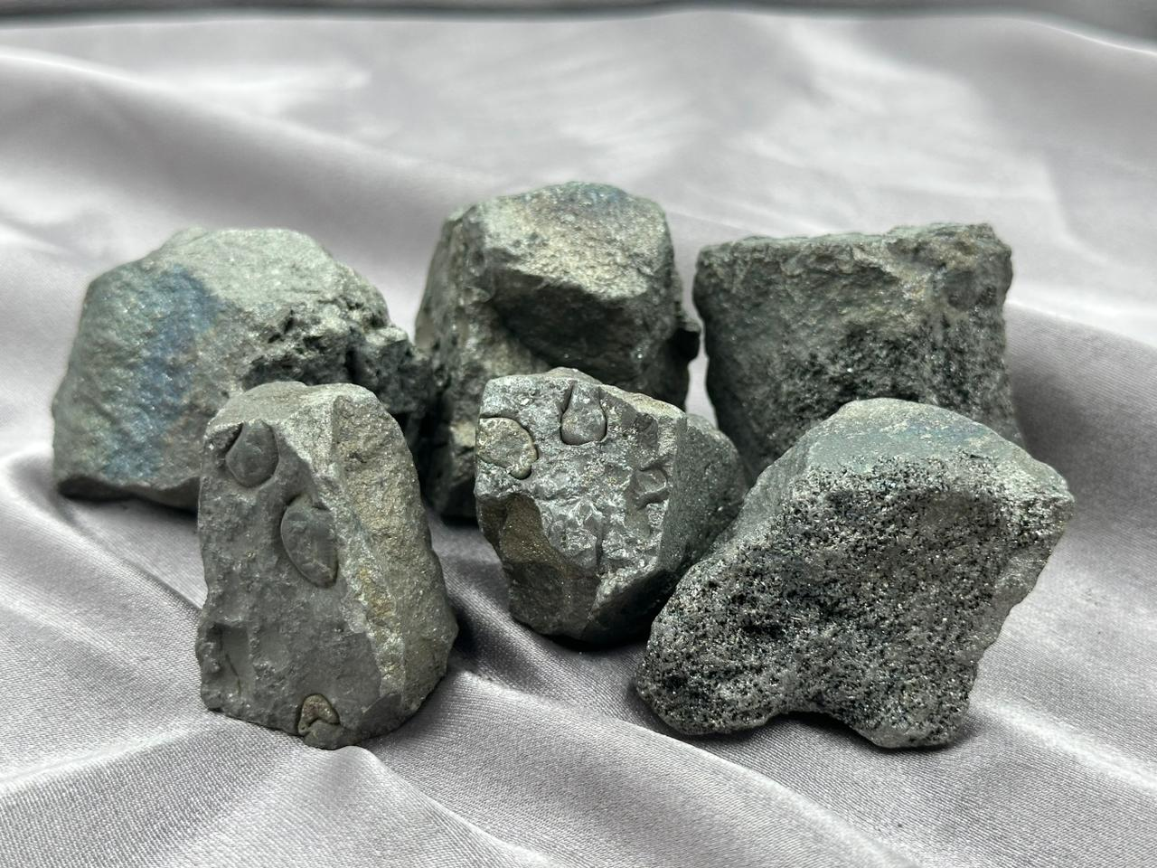
TUFF Silico Manganese (SiMn)

Slide 4
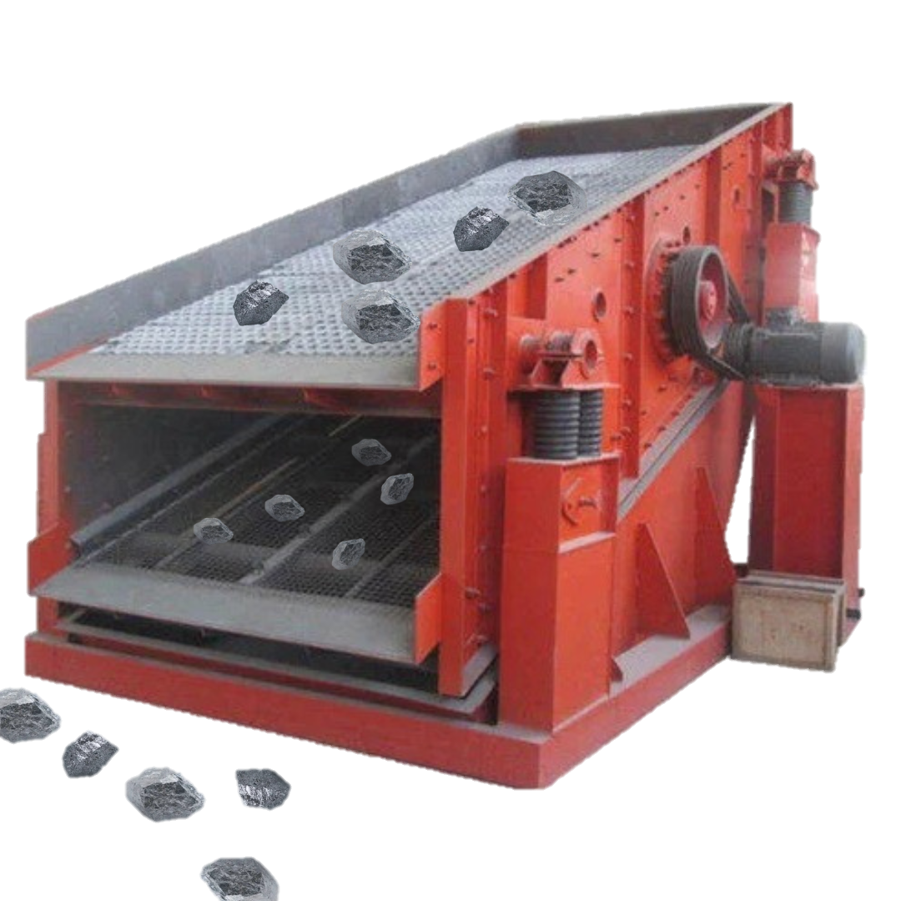
TUFF SILICO MANGANESE Silico Manganese is an alloy of manganese, silicon and iron. It is a cost- effective blend of manganese and silicon and is normally the product of choice for steel manufacturers. It is consumed in all steel products and used in higher quantities in 200 series stainless steel, alloy steel and manganese steel. Silico Manganese is used as a deoxidizer and an alloying element in steel. Ferro Silico Manganese can be used as a substitute for Ferro Silicon and Ferro Manganese when added to make different types of steel.
Specification of TUFF Ferro Silico Manganese
Silico Manganese 60 14
Manganese:60% min , Silicon:14% Min , Carbon: 2.50%Max, Phosphorus:0.30%Max, Sulphur:0.05% Max
Silico Manganese 65 16
Manganese:65% min , Silicon:16% Min , Carbon: 2.50%Max, Phosphorus:0.30%Max, Sulphur:0.05% Max
Silico Manganese 65 17
Manganese:65% min , Silicon:17% Min , Carbon: 2.50%Max, Phosphorus:0.30%Max, Sulphur:0.05% Max

Slide 5
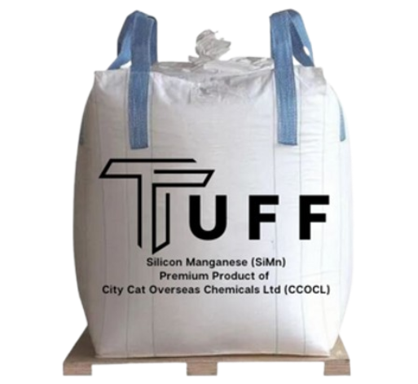
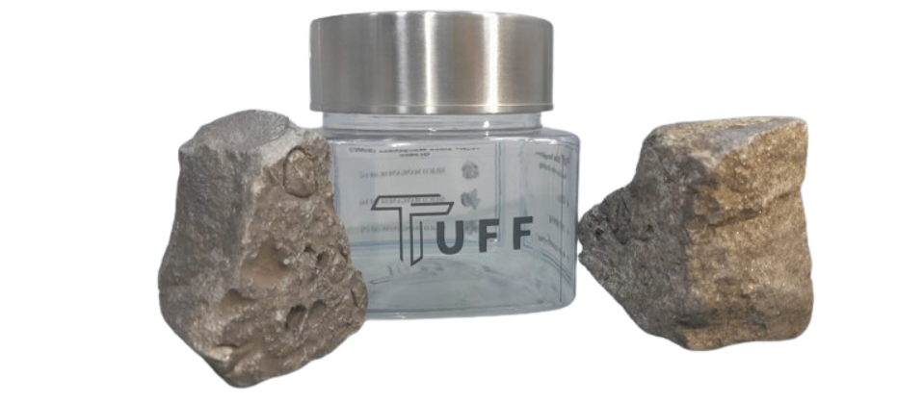
Packaging & Delivery
We deliver Ferro Silicon, Ferro Silicon Manganese, Ferro Chromium, minerals and Refractory items across the globe. Our standard delivery time is 4 - 6 weeks.

